Slide 1
Trees
Contrary to arrays, stacks, queues and sequences all of which are one-dimensional data structures.
Tree is a non linear data structure
Trees are two-dimensional data structures with hierarchical relationship between data items.
One node in the tree is designated as the root. Each tree has exactly one path between the root and each of the other nodes. If there is more than one path between the root and some node, or no path at all, we have a graph.

Slide 2
Example of a tree:
root
siblings
subtree
internal nodes
external nodes, or leaves

Slide 3
What is a Tree?
A tree is a non-empty collection of vertices (nodes) and edges that satisfy certain requirements.
Example:
  Nodes={A,B,C,D,E,f,G,H}
  Edges={(A,B),(A,E),(B,F),(B,G),(B,H),
  (E,C),(E,D)}
A directed path from node m1 to node m_{k} is a list of nodes m₁, m₂, . . . , m_{k} such that each is the parent of the next node in the list. The length of such a path is k – 1 where k is the number of nodes in a path.
Example: A, E, C is a directed path of length 2.
A
E
B
D
C
F
H
G

Slide 4
What is a Tree? (contd.)
A tree satisfies the following properties:
  It has one designated node, called the root, that has no parent.
  Every node, except the root, has exactly one parent.
  A node may have zero or more children.
  There is a unique directed path from the root to each node.
5
5
5
1
3
2
3
2
3
2
4
1
6
4
1
6
4
6
tree
Not a tree
Not a tree

Slide 5
Tree Terminology
Ordered tree: A tree in which the children of each node are linearly ordered (usually from left to right).
Ancestor of a node v: Any node, including v itself, on the path from the root to the node.
Proper ancestor of a node v: Any node, excluding v, on the path from the root to the node.
A
proper ancestors of E
Ancestors of G
B
C
D
E
F
G
An Ordered Tree

Slide 6
Tree Terminology (Contd.)
Descendant of a node v: Any node, including v itself, on any path from the node to a leaf node (i.e., a node with no children).
Proper descendant of a node v: Any node, excluding v, on any path from the node to a leaf node.
Subtree of a node v: A tree rooted at a child of v.
A
Proper descendants of node B
B
C
Descendants of a node C
D
E
F
G
A
B
C
D
E
F
G
subtrees of node A

Slide 7
Tree Terminology (Contd.)
A
A
parent of node D
B
C
grandfather of nodes I,J
D
E
G
F
child of node D
H
I
J
grandchildren of node C
subtrees of A
proper ancestors of node H
Right Sub tree of A
A
A
B
C
D
E
F
G
proper descendants of node C
H
I
J

Slide 8
Tree Terminology (Contd.)
An Ordered Tree with size of 10
Degree: The number of subtrees of a node
  Each of node D and B
  has degree 1.
  Each of node A and E
  has degree 2.
  Node C has degree 3.
  Each of node F,G,H,I,J has degree 0.
Leaf: A node with degree 0.
Internal or interior node: a node with degree greater than 0.
Siblings: Nodes that have the same parent.
Size: The number of nodes in a tree.
Siblings of A
A
A
B
C
D
E
G
F
H
I
J
Siblings of E

Slide 9
Tree Terminology (Contd.)
Level (or depth) of a node v: The length of the path from the root to v
OR
It is the number of nodes on the path from that node to the root.
Height of a node v: The length of the longest path from v to a leaf node.
Height of a tree T (maximum distance) :It is the maximum level among all of the nodes in the tree.
  The height of a tree is the max level number.
  By definition the height of an empty tree is -1.
Level 0
Level 1
Level 2
Level 3
Level 4
A
A
The height of the tree is 4.
The height of node C is 3.
B
C
D
E
F
G
H
I
J
k

Slide 10
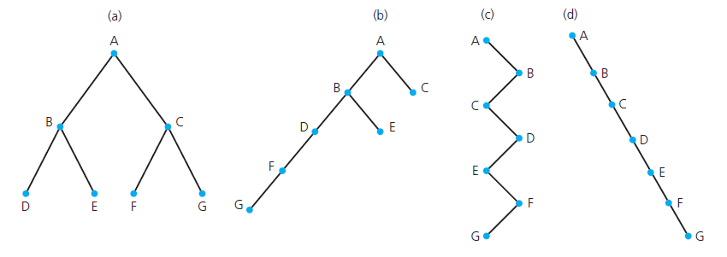
Finding Height

Slide 11
Tree Properties
A
Property Value
Number of nodes
Height
Root Node
Leaves
Interior nodes
Number of levels
Ancestors of H
Descendants of B
Siblings of E
Right subtree
B
C
D
E
F
G
H
I

Slide 12
Why Trees?
Trees are very important data structures in computing.
They are suitable for:
  Hierarchical structure representation, e.g.,
    File directory.
    Organizational structure of an institution.
    Class inheritance tree.

Slide 13
An operating system maintains a disk's file system as a tree, where file folders act as tree nodes:
    A tree can represent a structured object, such as a house that must be explored by a robot or a human player in an adventure game:
Trees are used to represent phrase structure of sentences, which is crucial to language processing programs

Slide 14
A Tree Node
Every tree node:
  object – useful information
  children – pointers to its children nodes
O
O
O
O
O

Slide 15
Kinds of Trees
General Tree or a Rooted tree
  Set T of one or more nodes such that T is partitioned into disjoint subsets
  A single node r , the root
  Sets that are general trees, called subtrees of r

Slide 16
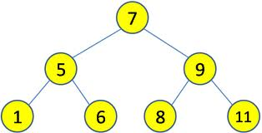
Kinds of Trees
Ordered Tree
“It is a rooted tree but in it the order of the
children is specified.”

Slide 17
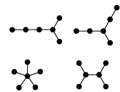
Kinds of Trees
Free Tree
“A free tree is a tree that is not rooted”

Slide 18
Kinds of Trees
  , a n-ary tree is a rooted tree in which each node has no more thann children
  Example of N-ary trees:
5
B
2
7
D
D
F
2-ary (binary) tree
3-ary (tertiary)tree
9
5
C
G
B
J
E
A

Slide 19
Kinds of Trees
Binary tree
A binary tree is an N-ary tree for which N = 2.
Thus, a binary tree is either:
  An empty tree, or
  A tree consisting of a root node and at most two non-empty binary subtrees.

Slide 20
Generalization
Binary or n-ary tree is a special type of ordered tree.
An ordered tree is a special type of rooted tree.
A rooted tree is a special type of free tree.

Slide 21
Binary Trees (Contd.)
A full binary tree is either an empty binary tree or a binary tree in which each level k, k > 0, has 2^{k} nodes.
A complete binary tree is either an empty binary tree or a binary tree in which:
  Each level k, k > 0, other than the last level contains the maximum number of nodes for that level, that is 2^{k}.
  The last level may or may not contain the maximum number of nodes.
  If a slot with a missing node is encountered when scanning the last level in a left to right direction, then all remaining slots in the level must be empty.
Thus, every full binary tree is a complete binary tree, but the opposite is not true.

Slide 22
Binary Trees (Contd.)
Example showing the growth of a complete binary tree:

Slide 23
Properties of Binary Tree
The number of external nodes is at least h + 1, where h is the height of the tree, and at most 2^{h} . The later holds for a full binary tree, which is a tree where internal nodes completely fill every level.
The number of internal nodes is at least h and at most 2^{h} -1.
The total number of nodes in a binary tree is at least 2*h + 1 and at most 2^{h+1} - 1.
The height, h, of a binary tree with n nodes is at least log n and at most n -1 .
A binary tree with n nodes has exactly n - 1 edges.

Slide 24
Properties of a Complete Binary Tree
The following property holds for a complete binary tree.
Let i be a number assigned to a node in a complete binary tree. Then:
1. If i = 1, then this node is the root of the tree. If i > 1, then the parent of this node is assigned the number (i / 2).
2. If 2*i > n, then the corresponding node has no left child. Otherwise, the left child of that node is assigned the number 2*i.
3. If 2*i + 1 > n, then the corresponding node has no right child. Otherwise, the right child of that node is assigned the number 2*i + 1.

Slide 25
Operations (methods) on binary trees
empty () - Returns true if the binary tree is empty
getRoot () - Returns the root node of the tree
leftChild (node) - Returns the left child of node.
rightChild (node) -Returns the right child of node.
expandExternal(node) - Makes node internal by creating its left and right children
removeAboveExternal(node) - Removes an external node together with its parent
insert (node) - Inserts node in the appropriate position in the tree
delete (node) - Deletes node

Slide 26
Linear (or sequence-based) representation of a binary tree
Linear representation of a binary tree utilizes one-dimensional array of size
2^{h+1} - 1. Consider the following tree:
+ level 0 (d = 0)
- * level 1 (d = 1)
A B C / level 2 (d = 2)
E F level 3 (d = 3)
To represent this tree, we need an array of size 2³⁺¹ - 1 = 15
The tree is represented as follows:
1. The root is stored in BinaryTree[1].
2. For node BinaryTree[n], the left child is stored in BinaryTree[2*n], and the right child is stored in BinaryTree[2*n+1]
i: 1 2 3 4 5 6 7 8 9 10 11 12 13 14 15
BinaryTree[i]: + - * A B C / E F

Slide 27
Linear representation of a binary tree (cont.)
Advantages of linear representation:
1. Simplicity.
2. Given the location of the child (say, k), the location of the parent is easy to determine (k / 2).
Disadvantages of linear representation:
1. Additions and deletions of nodes are inefficient, because of the data movements in the array.
2. Space is wasted if the binary tree is not complete. That is, the linear representation is useful if the number of missing nodes is small.

Slide 28
Linked representation of a binary tree
Linked representation uses explicit links to connect the nodes. Example:
1
2 5
3 4 6 7
8 9
Nodes in this tree can be viewed as positions in a sequence (numbered 1
through 9).
+
-
*
A
B
C
/
E
F

Slide 29
Binary tree nodes (linked representation)
class BTNode {
char data;
BTNode leftChild;
BTNode rightChild;
BTNode parent;
int pos;
public BTNode () { }
public BTNode (char newData) {
data = newData; }
public BTNode (char newData, BTNode newLeftChild, BTNode newRightChild)
{ data = newData;
leftChild = newLeftChild;
rightChild = newRightChild; }
... methods setData, setLeftChild, setRightChild, getData, getLeftChild, getRightChild,
displayBTNode follow next ...
}

Slide 30
Binary tree (linked representation)
We can use a positional sequence ADT to implement a binary tree. Our
example tree, in this case, we be represented as follows:
position 1 2 3 4 5 6 7 8 9
data + - A B * C / E F
leftChild 2 3 null null 6 null 8 null null
rightChild 5 4 null null 7 null 9 null null
parent null 1 2 2 1 5 5 7 7

Slide 31
Tree Traversal
preOrder() - Visit the root, then the left subtree, then the right subtree
postOrder () - Visit the left subtree, then the right subtree, then the root
inOrder() - Visit the left subtree, then the root, then the right subtree
levelOrder () - Starting from the root, visit tree nodes level by level

Slide 32
Pre Order Traversal
public void preOrder (BTNode localRoot)
{
if (localRoot != null)
{
localRoot.displayBTNode();
preOrder(localRoot.leftChild);
preOrder(localRoot.rightChild);
}
}

Slide 33
Post Order Traversal
public void postOrder (BTNode localRoot)
{
if (localRoot != null)
{
postOrder(localRoot.leftChild);
postOrder(localRoot.rightChild);
localRoot.displayBTNode();
}
}

Slide 34
In Order Traversal
public void inOrder (BTNode localRoot)
{
if (localRoot != null)
{
inOrder(localRoot.leftChild);
localRoot.displayBTNode();
inOrder(localRoot.rightChild);
}
}

Slide 35
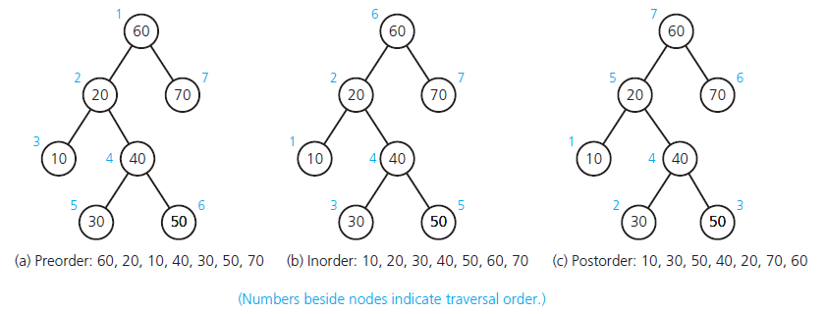
Traversing

Slide 36
Level-order Traversal
Implementation: not recursive.
Use a queue: which initially contains only the root.
Repeat, dequeue a node from the list
, visit it
,enqueue its children (left to right)
Until queue is empty

Slide 37
Binary Tree Operations
Test whether a binary tree is empty.
Get the height of a binary tree.
Get the number of nodes in a binary tree.
Get the data in a binary tree’s root.
Set the data in a binary tree’s root.
Add a new node containing a given data item to a binary tree.
Data Structures and Problem Solving with C++: Walls and Mirrors, Carrano and Henry, © 2013

Slide 38
Binary Tree Operations
Remove the node containing a given data item from a binary tree.
Remove all nodes from a binary tree.
Retrieve a specific entry in a binary tree.
Test whether a binary tree contains a specific entry.
Traverse the nodes in a binary tree in preorder, inorder, or postorder.
Data Structures and Problem Solving with C++: Walls and Mirrors, Carrano and Henry, © 2013

Slide 39
Level Order Traversal
public void levelOrder (BTNode localRoot) {
BTNode[] queue = new BTNode[20];
int front = 0; int rear = -1;
while (localRoot != null) {
localRoot.displayBTNode();
if (localRoot.leftChild != null) {
rear++;
queue[rear] = localRoot.leftChild; }
if (localRoot.rightChild != null) {
rear++;
queue[rear] = localRoot.rightChild; }
localRoot = queue[front];
front++; } }

Slide 40
Binary Search Tree
For each node n, a binary search tree satisfies the following three properties:
  n ’s value is greater than all values in its left subtree T _{L} .
  n ’s value is less than all values in its right subtree T _{R} .
  Both T _{L} and T _{R} are binary search trees.

Slide 41
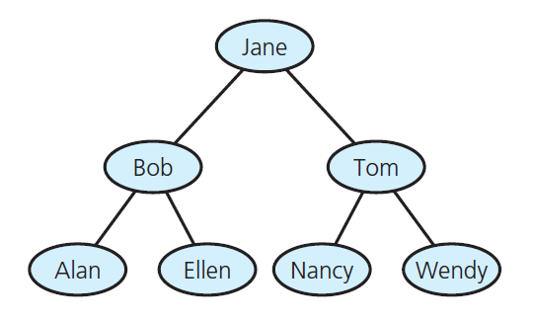
Binary Search Tree
FIGURE 15-4 A binary search tree of names

Slide 42
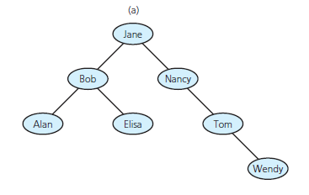
The ADT Binary Search Tree
FIGURE 15-14 Binary search trees
with the same data as in Figure 15-13
Data Structures and Problem Solving with C++: Walls and Mirrors, Carrano and Henry, © 2013

Slide 43
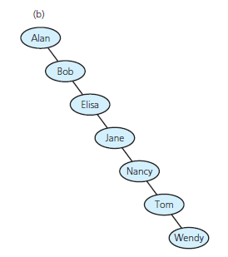
The ADT Binary Search Tree
FIGURE 15-14 Binary search trees
with the same data as in Figure 15-13
Data Structures and Problem Solving with C++: Walls and Mirrors, Carrano and Henry, © 2013

Slide 44
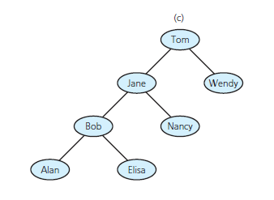
The ADT Binary Search Tree
FIGURE 15-14 Binary search trees
with the same data as in Figure 15-13
Data Structures and Problem Solving with C++: Walls and Mirrors, Carrano and Henry, © 2013

Slide 45
Binary Search Tree Operations
Test whether binary search tree is empty.
Get height of binary search tree.
Get number of nodes in binary search tree.
Get data in binary search tree’s root.
Insert new item into binary search tree.
Remove given item from binary search tree.
Data Structures and Problem Solving with C++: Walls and Mirrors, Carrano and Henry, © 2013

Slide 46
Binary Search Tree Operations
Remove all entries from binary search tree.
Retrieve given item from binary search tree.
Test whether binary search tree contains specific entry.
Traverse items in binary search tree in
  Preorder
  Inorder
  Postorder.
Data Structures and Problem Solving with C++: Walls and Mirrors, Carrano and Henry, © 2013

Slide 47
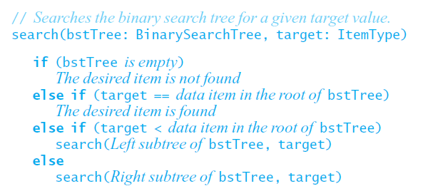
Searching a Binary Search Tree
Search algorithm for binary search tree
Data Structures and Problem Solving with C++: Walls and Mirrors, Carrano and Henry, © 2013

Slide 48
Insertion in binary search tree
Insert 9 in the the following tree:
3
2 15
1 11
7 13
Step 1: search for 9 3
2 15
1 11
search stops here 7 13
Step 2: insert 9 at the point where the search terminates unsuccessfully
3
2 15
1 11
7 13 That is, new nodes are always inserted at the leaf level.
9

Slide 49
Binary Tree with an ordering property: the insert method
class BTLRADT {
BTNode root;
public BTLRADT () { }
public BTNode getRoot () {
return root; }
public void insert (char newData) {
BTNode newNode = new BTNode ();
newNode.data = newData;
if (root == null)
root = newNode;
else {
BTNode temp = root;
BTNode parent;
while (true) {
parent = temp;
if (newData < temp.data) { //go left
temp = temp.leftChild;
if (temp == null) {
parent.leftChild = newNode;
return; }
}
else { // go right
temp = temp.rightChild;
if (temp == null) {
parent.rightChild = newNode;
return;
}
}
}
}
}

Slide 50
Deletion in binary search tree
Consider the tree:
3 7
2 15 Deleting 3 2 15
1 11 1 11
7 13 13
The following cases of deletions are possible:
1. Delete a note with no children, for example 1. This only requires the appropriate link in the parent node to be made null.
2. Delete a node which has only one child, for example 15. In this case, we must set the corresponding child link of the parent’s parent to point to the only child of the node being deleted.
3. Delete a node with two children, for example 3. The delete method is based on the following consideration: in-order traversal of the resulting tree (after delete operation) must yield an ordered list. To ensure this, the following steps are carried out:
Step 1: Replace 3 with the node with the next largest datum, i.e. 7.
Step 2: Make the left link of 11 point to the right child of 7 (which is null here).
Step 3: Copy the links from the node containing 3 to the node containing 7, and make the parent node of 3 point to 7.

Slide 51
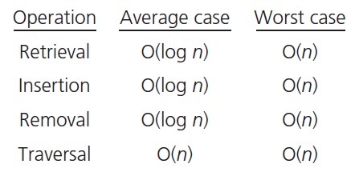
Efficiency of Binary Search Tree Operations
Data Structures and Problem Solving with C++: Walls and Mirrors, Carrano and Henry, © 2013

Slide 52


Slide 53
int sum= 0;
for(i=1; i<n; i++)
for(j=n; j>0; j--)
for(k=1; k<n; k++)
sum+= (i+j *k);
a. What are total number of primitive operations [10]
b. Calculate the c and n₀ values for Oh- notation [5+5]
c. Calculate the c and n₀ values for Omega- notation [5+5]
d. Calculate the total number of time the sum statement execute when n is 5. Also give general formula. [5+5]

Slide 54
Ques 2: Consider the following Java method that returns true if an array of n intergers has two adjacent values that are the same, false otherwise:
public static boolean adjacentDuplicates (int[] a)
{
for (int i=0; i<a.length-1; i++)
if (a[i]) == a[i+1]
return true;
return false;
}

Slide 55
Delete the k^{th} node in the doubly linked list where k = m. The size of doubly linked list is l where l >= m. The head and tail nodes are present in the list. [15]

